Slide 1
Retail Giant Sales Forecasting using timer series ANALYSIS
Group Members:
Vijayanand Narayanan
Arunachalam Meenakshisundaram
Akash Ashokan
Dharamarajan Thiyagarajan

Slide 2
Business Problem
Global Mart is an online retail store that takes orders and delivers worldwide. The company caters to 7 Markets (Africa, APAC, Canada, EMEA, EU, LATAM and US) and 3 Segments (Consumer, Corporate and Home Office).
The company wishes to finalise the operations plan for the next 6 months. So, it is required to forecast the sales and the demand for the next 6 months, that would help the company manage the revenue and inventory accordingly.

Slide 3
Objectives
Carry out research and conduct analysis using the store’s past data to fulfil the following objectives,
Identify top 2 consistently profitable segments using Coefficient of Variation of profit
Forecast Sales and Demand for next 6 months in future using Classical Decomposition and Auto ARIMA methods

Slide 4
Problem Solving Methodology
Understand the business problem
Define project objectives and expected outcomes
Use dataset that has been provided
Clean data and address all data quality issues
Perform Exploratory Data Analysis by creating buckets based on Market and Segment
Select the top 2 consistently profitable segments using Coefficient of Variation of profit
Create Training and Test datasets
Develop a Time Series model using Classical Decomposition and then using ARIMA to compare and contrast the sales and demand predictions
Fine tune model to best fit
Select the appropriate model based on MAPE performance metrics
Predict Sales and Demand for the last 6 months using test data
Verify quality of prediction
Predict values for next 6 months in future

Slide 5
Data
Data from Global Superstore.csv dataset was used to carry out the time series analysis.
There were 51290 Observations and 25 Variables
Variables predominantly used in the analysis were Market, Segment, OrderDate, Sales, Quantity and Profit
A new variable YearMonth was created by extracting value from OrderDate in order to generate monthly summary of Sales, Demand and Profit

Slide 6
Data Cleaning
Following steps were taken to clean up the super store data
Checked for duplicate records
Handled missing values. Postal.Code variable had 41296 missing values. It was confirmed with additional checks that postal code was populate only for all US orders and there was a missing value for other countries
Converted character to date format. Both Order.Date and Ship.Date were converted to Date format

Slide 7
Data Preparation
There were 7 Markets and 3 Segments. Created 21 buckets for Market and Segments
Aggregated Profit for each market segment over all dates to to identify top 2 most profitable segments
Calculated CV of Profit i.e Std Dev(Profit)*100/ Mean(Profit) and aggregated CV of Profit for each market segment over all dates to identify top 2 most consistently profitable segments
Aggregated Sales, Quantity & Profit over the Order Date to arrive at monthly values for these attributes to use for Time Series Analysis

Slide 8
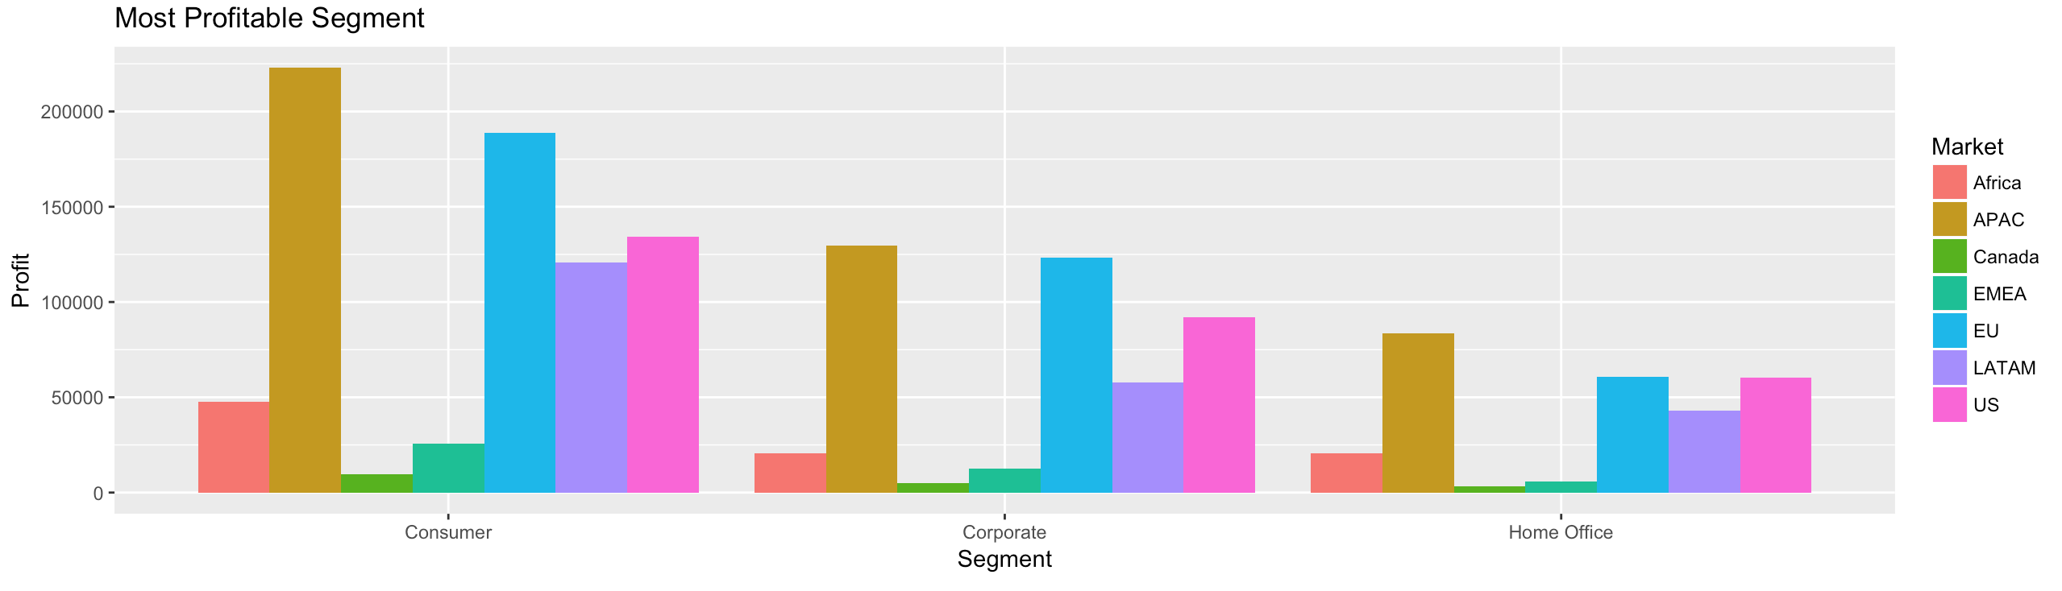
Top 2 Profitable Segments
APAC Consumer and EU Consumer segments were the top 2 profitable segments based on net profit

Slide 9
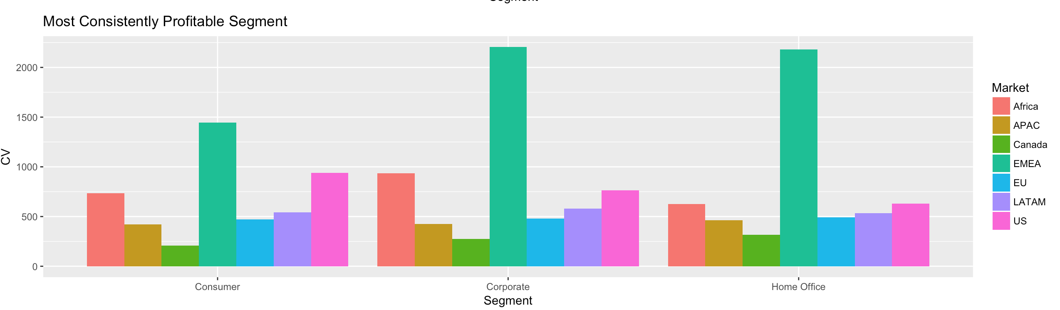
CV of Segments
Canada Consumer and Canada Corporate segments have the least Coefficient of Variation of profit
APAC and EU Consumer segments have low CV values

Slide 10
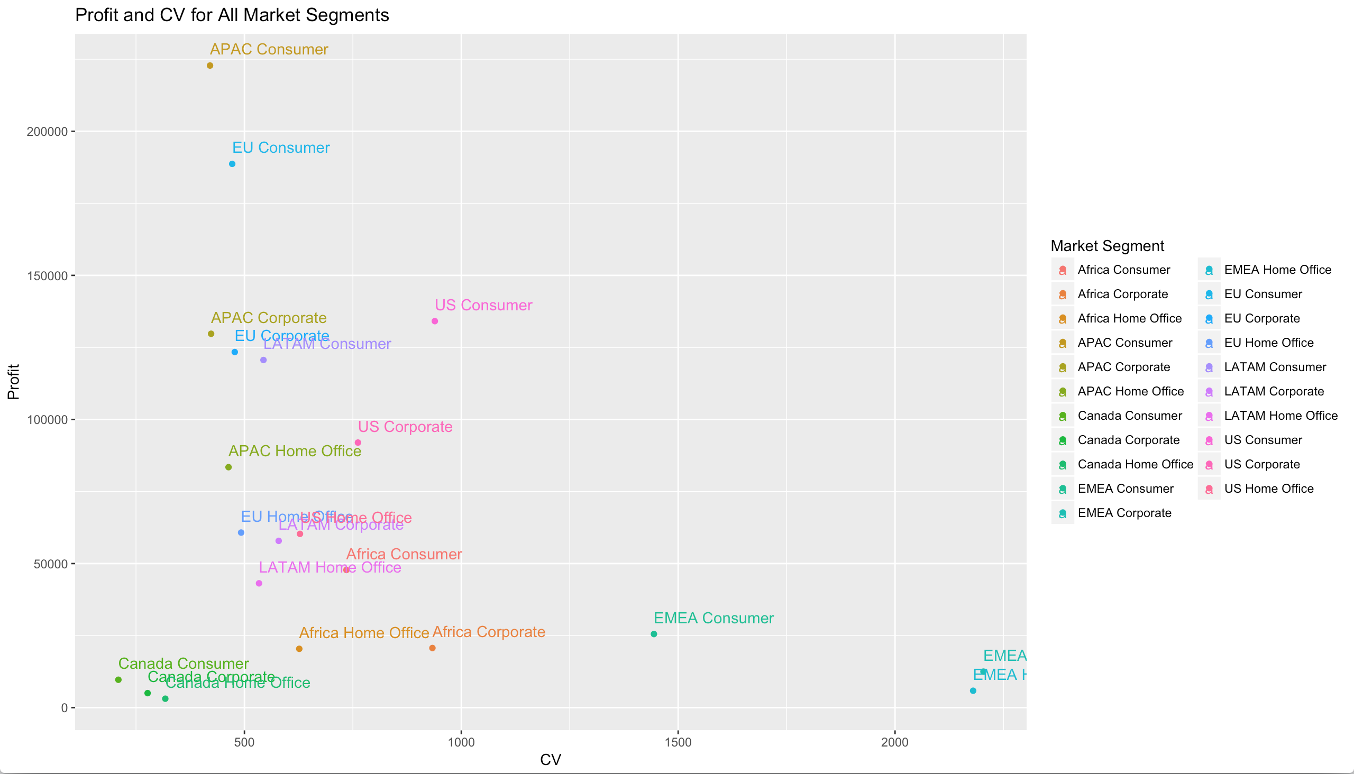
Top 2 Consistently Profitable Segments
APAC Consumer and EU Consumer segments were the top 2 consistently profitable segments based on a combination of maximum profits and least Coefficient of Variation of profit

Slide 11
Model Building – Part 1
Filtered out observations for APAC Consumer and EU Consumer segments
Created Time Series for Sales and Quantity (Demand)
Set aside last 6 months data for validation
Smoothened series using Moving Average with window size of 3
Plotted Time Series Sales and Demand to identify any Global Trends and Seasonality
For Classical Decomposition approach, used linear regression to capture trend and seasonality and used it predict values for Sales and Demand
Removed the trend and seasonality to create a residual time series
Carried out stationarity tests (ACF, PACF and Auto ARIMA) on residual time series to confirm that there is no local predictable behaviour
Used Quartile Quartile plot, Dickey-Fuller and KPSS tests to check for white noise

Slide 12
Model Building – Part 2
Predicted last 6 months Sales and Demand values using a linear regression model
Plotted predictions against original values
In Auto ARIMA approach called auto.arima function by passing in the time series for Sales and Demand
Checked for stationarity in residual time series using ACF, PACF
Checked for white noise using Dickey-Fuller and KPSS
Predicted last 6 months Sales and Demand values using the Auto ARIMA model

Slide 13
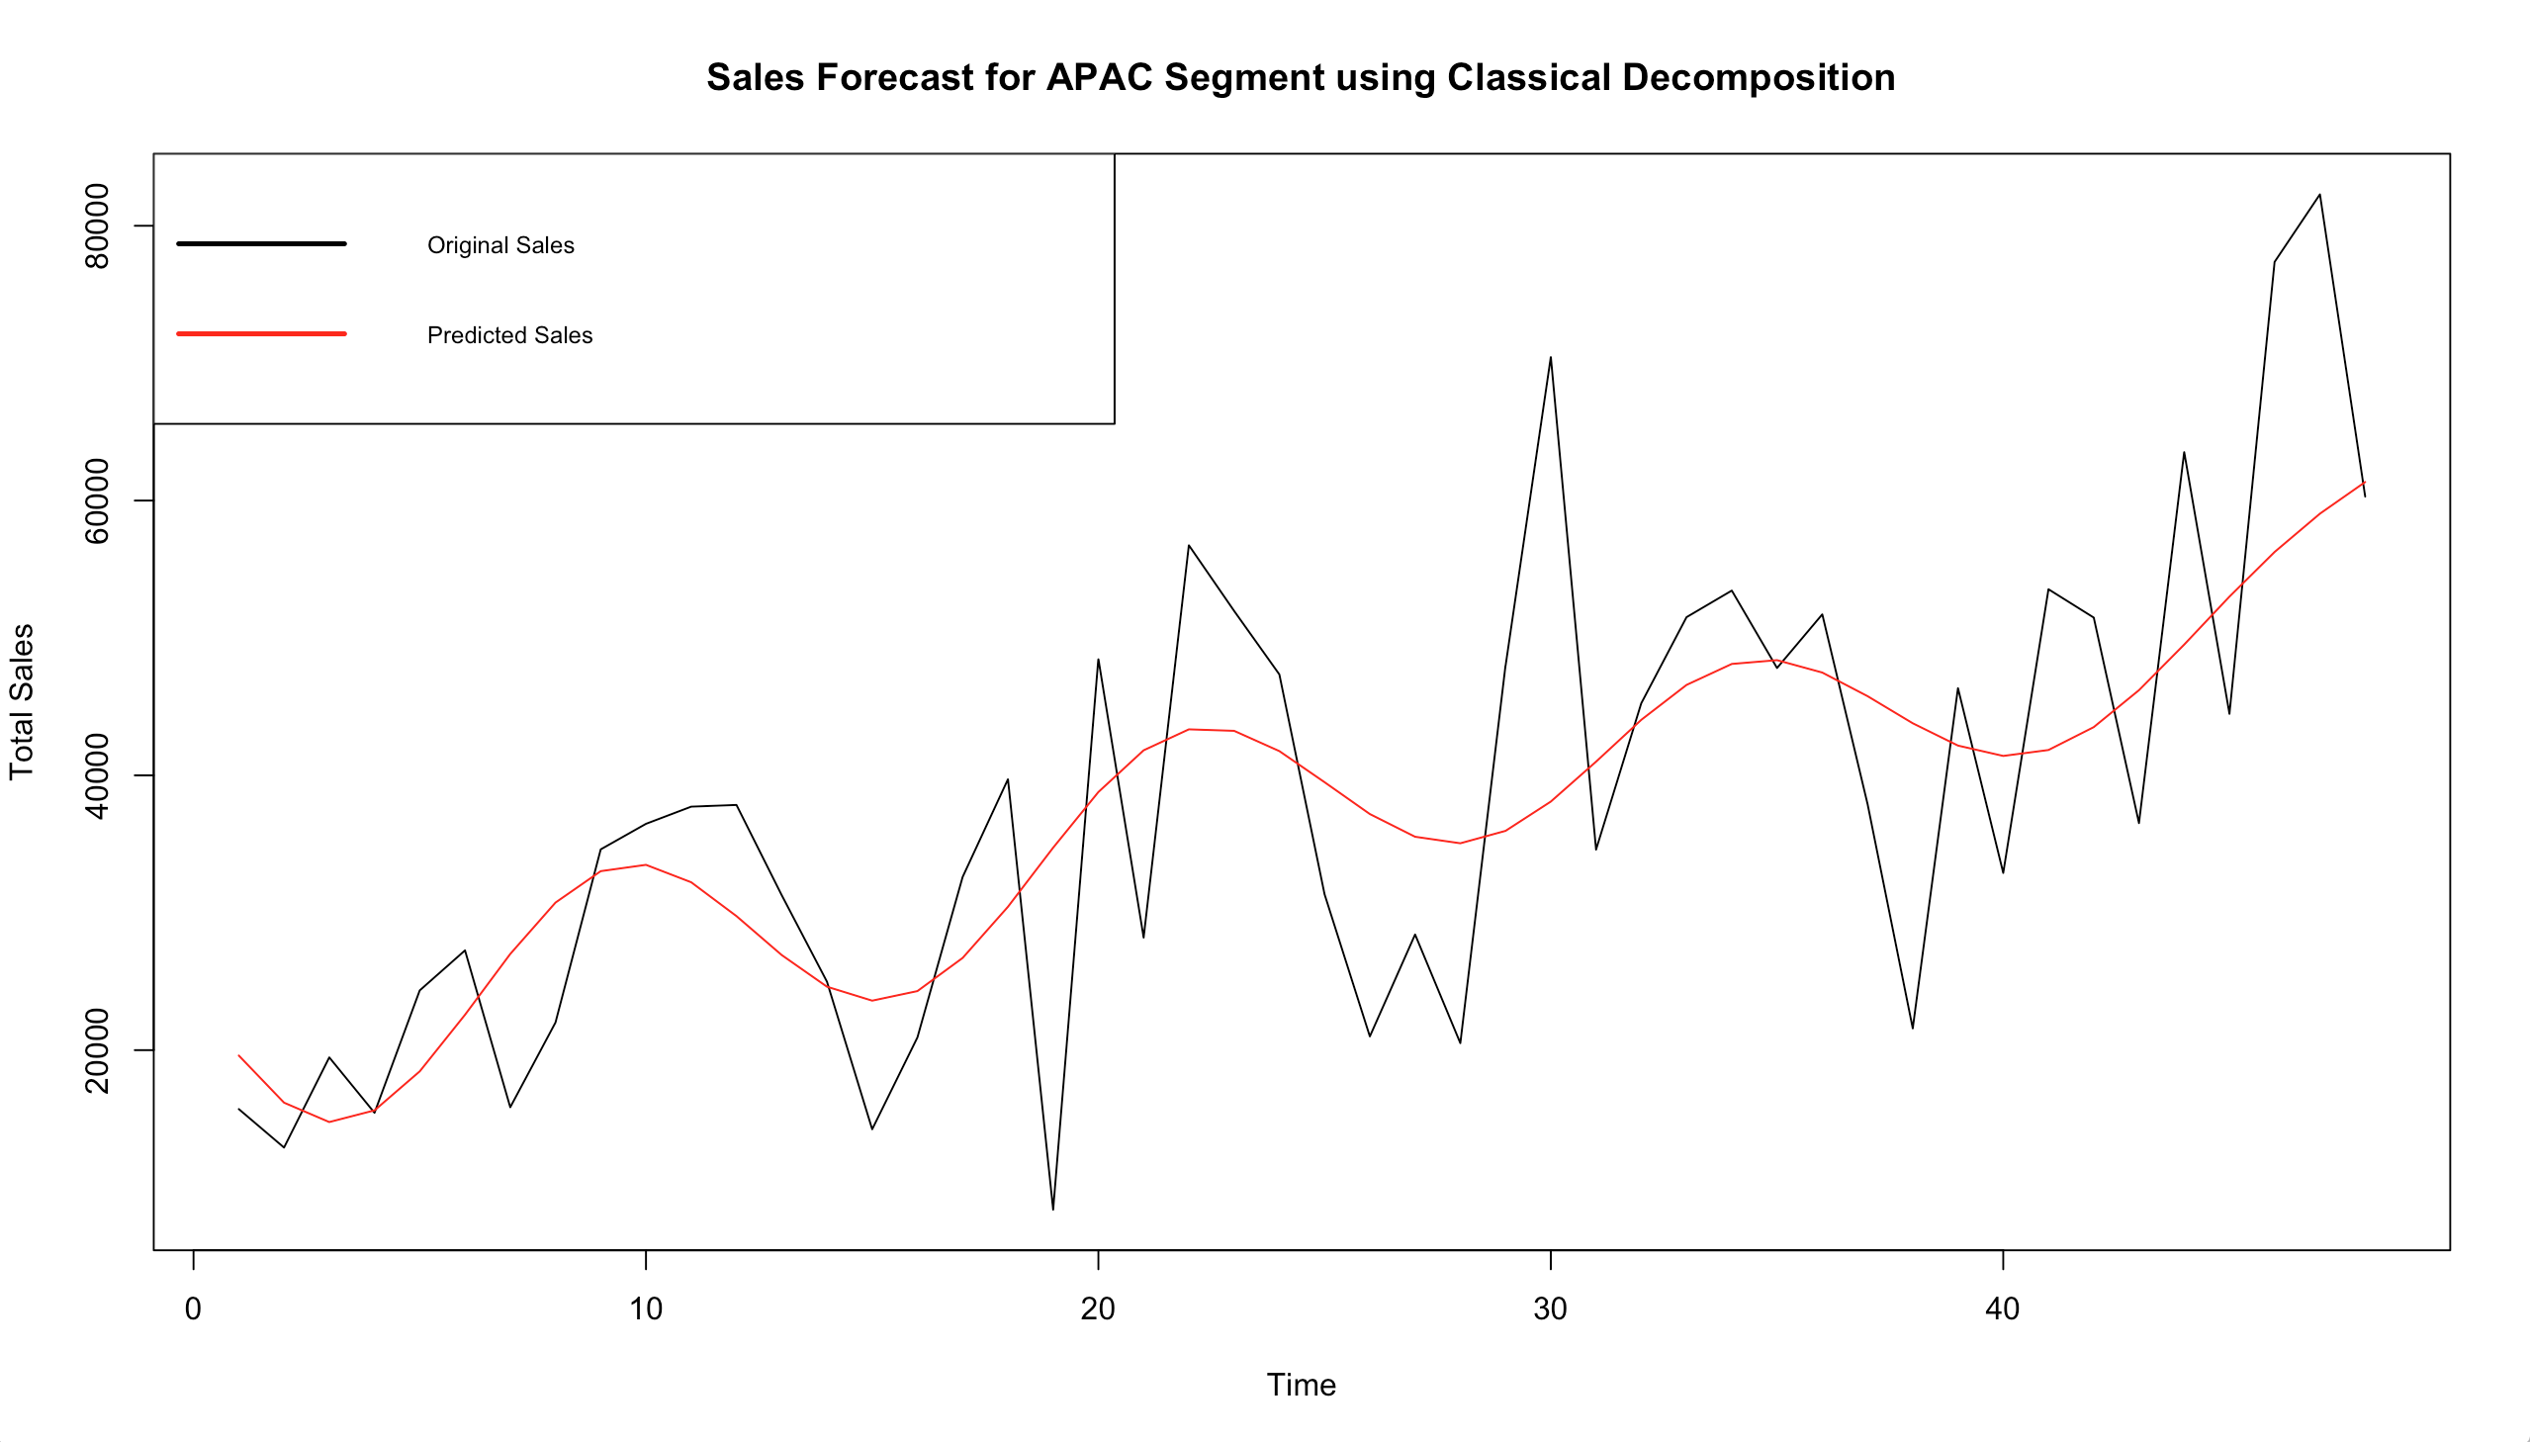
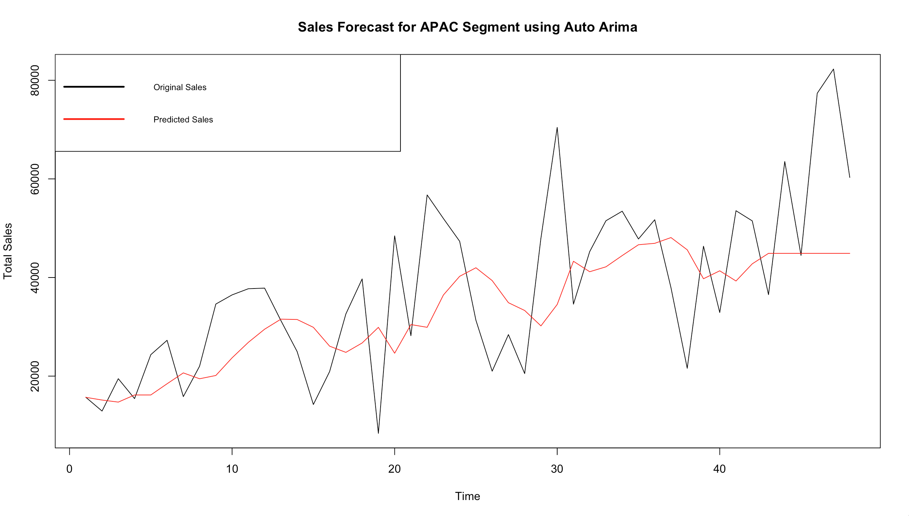
APAC Sales Forecast Comparison

Slide 14
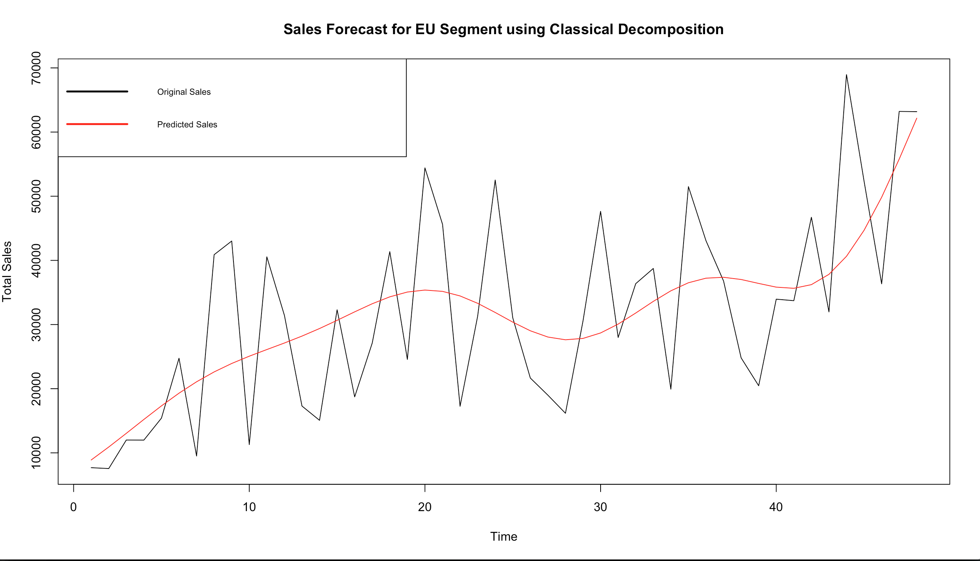
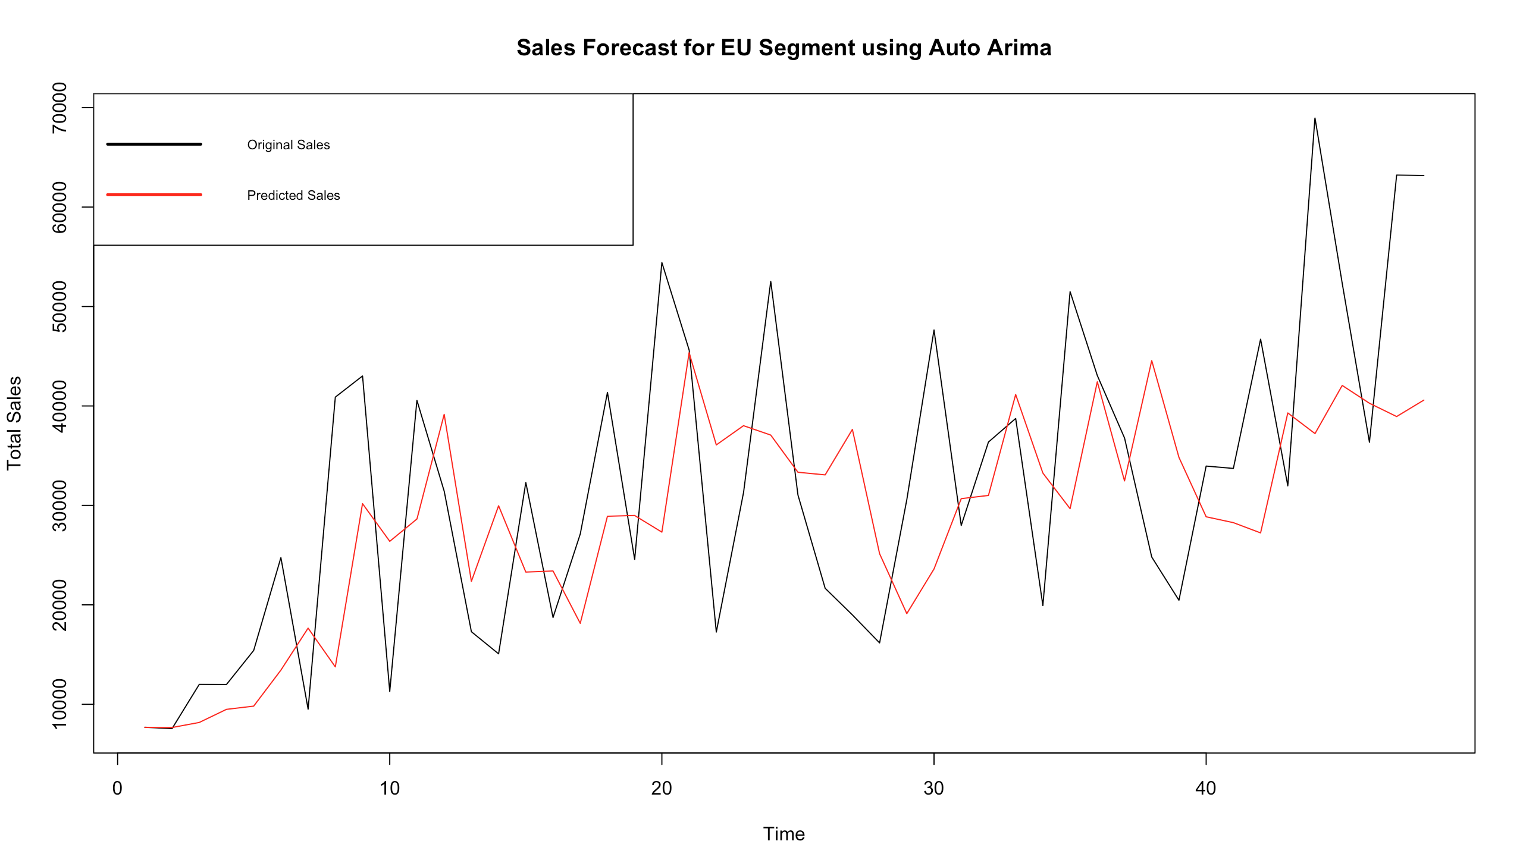
EU Sales Forecast Comparison

Slide 15
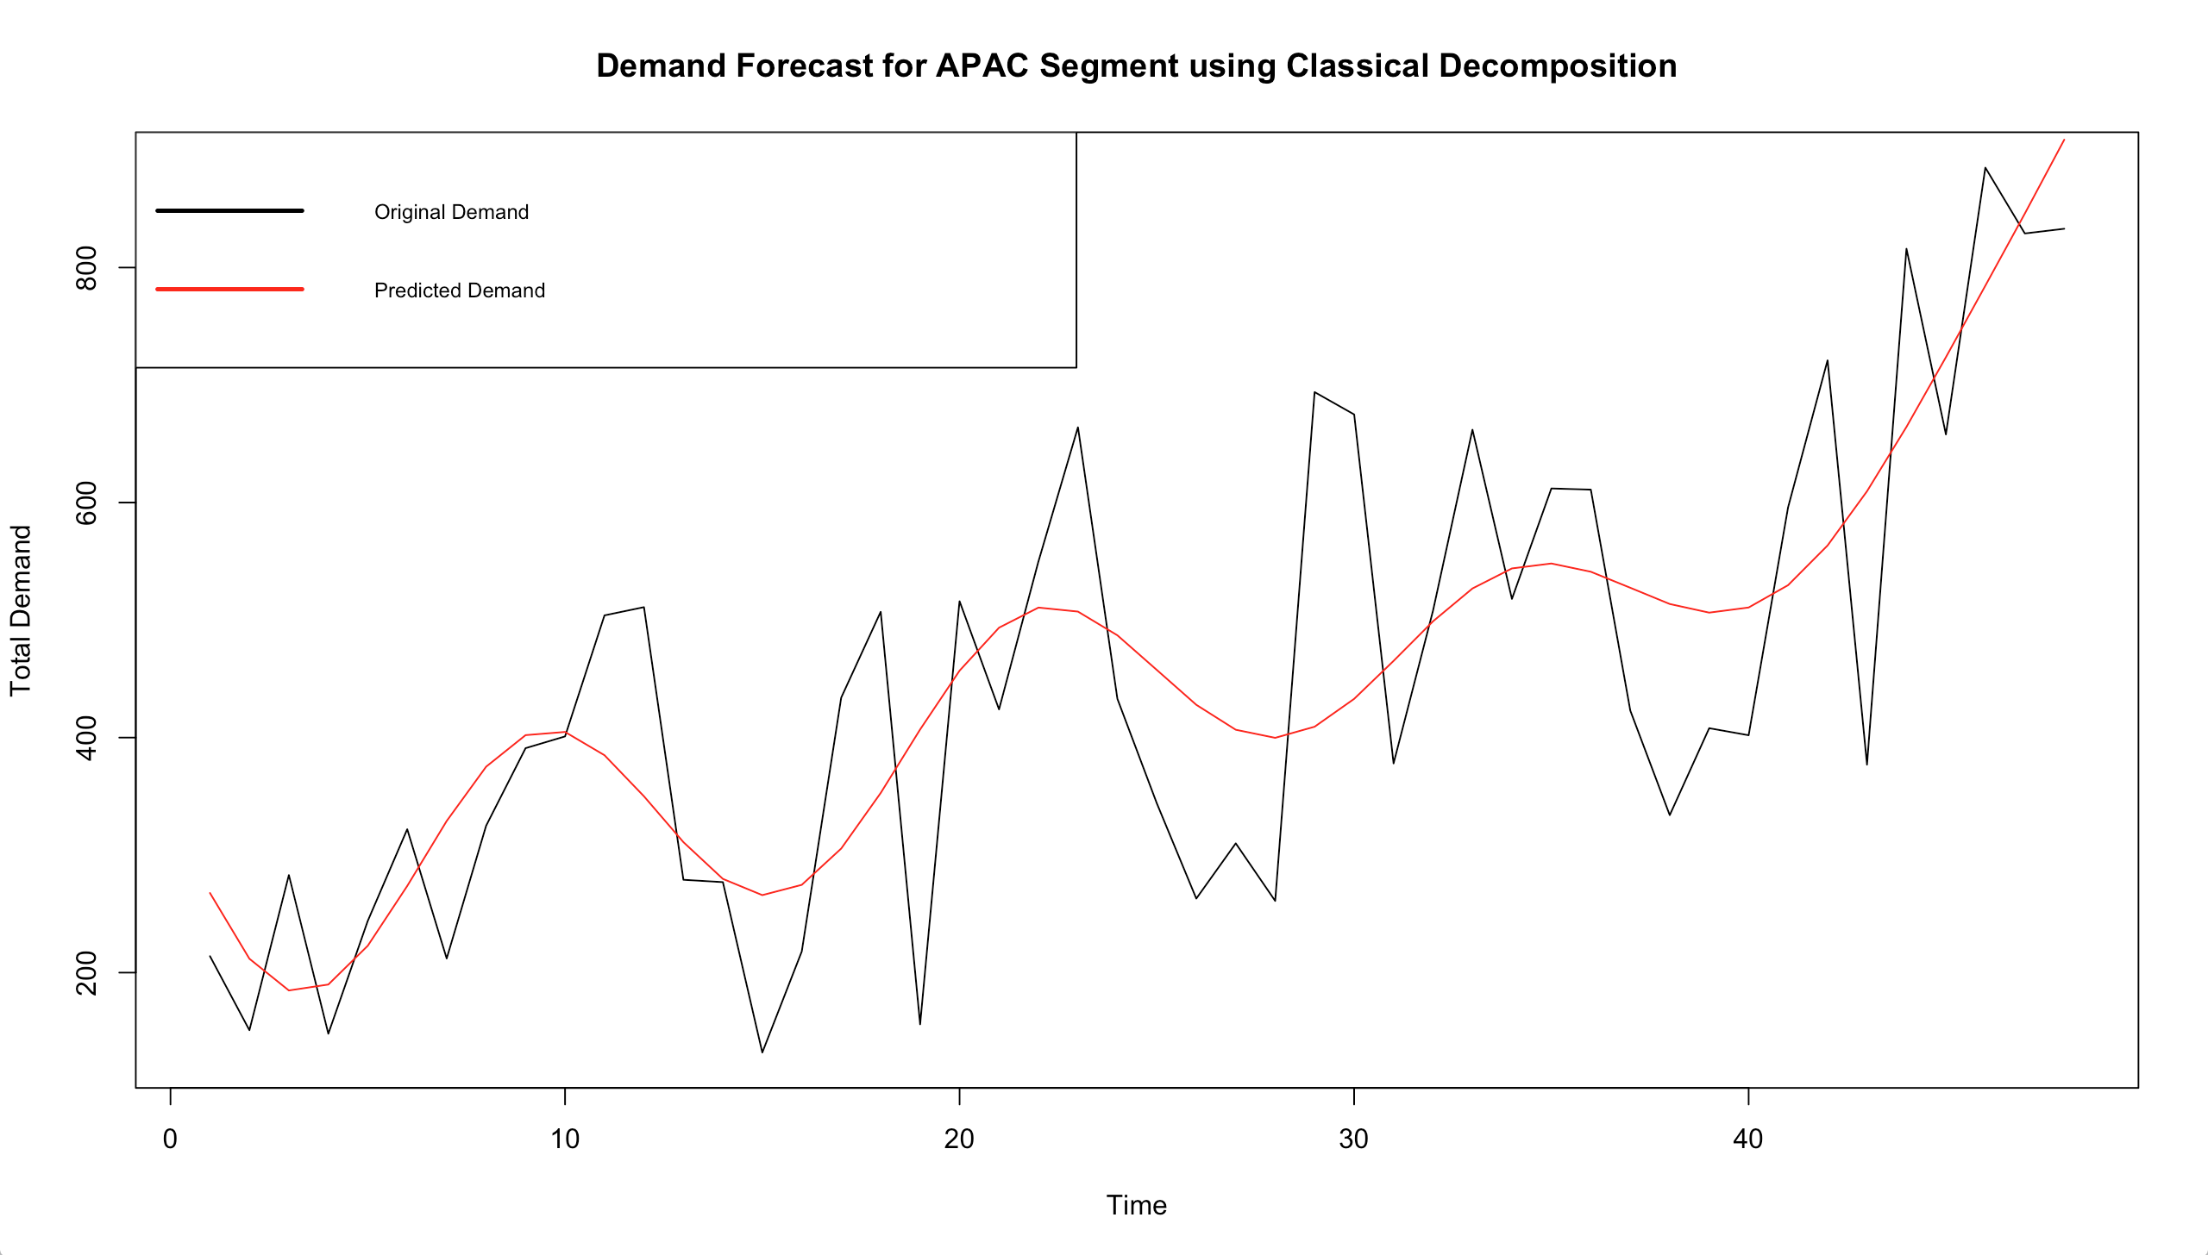
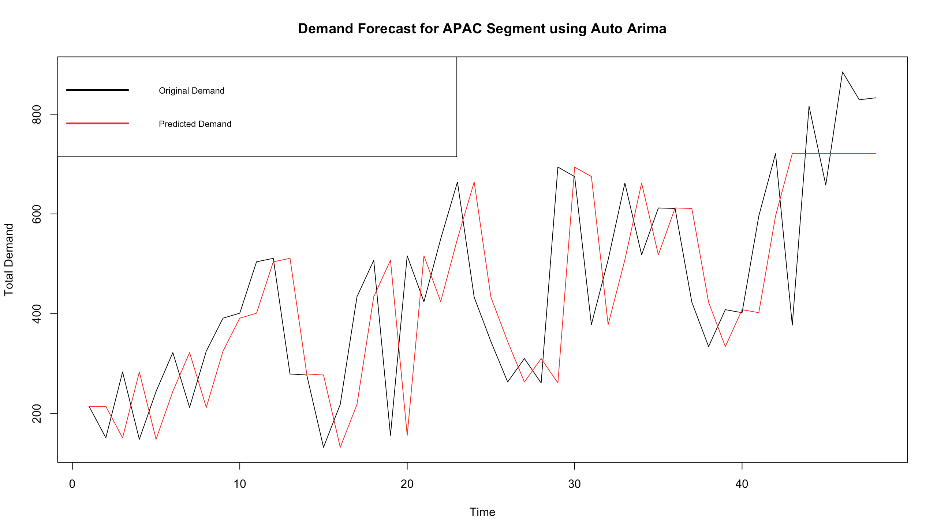
APAC Demand Forecast Comparison

Slide 16
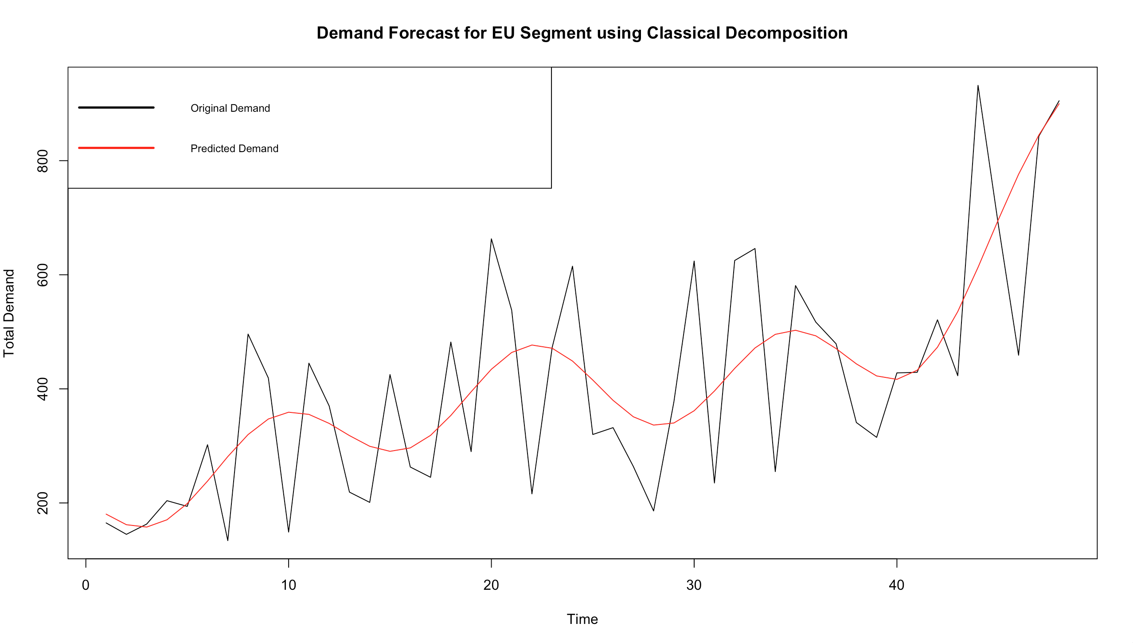
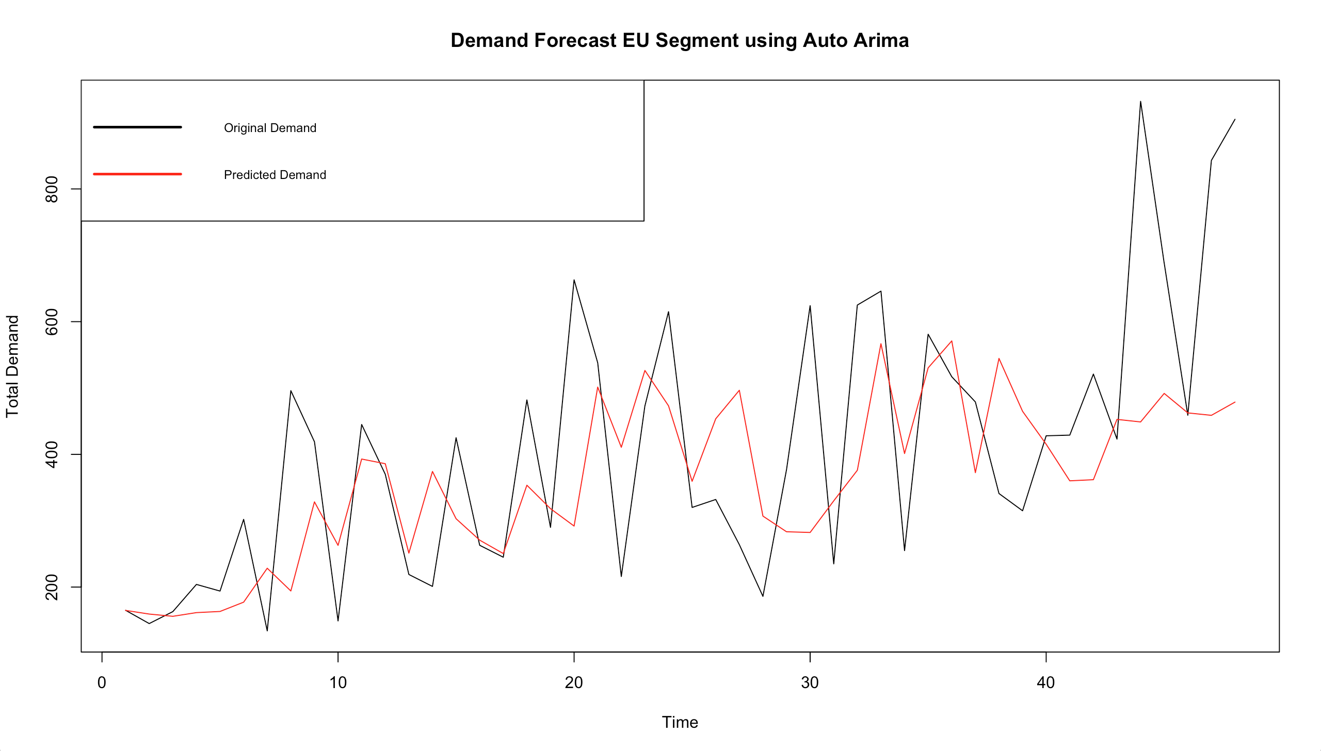
EU Demand Forecast Comparison

Slide 17
APAC Consumer Sales Model Evaluation
Market Segment | Evaluation Parameter | Classical Decomposition model | Auto ARIMA model
APAC Consumer Sales | Global behaviour | lm(Sales ~ sin(0.5*Month) * poly(Month,1) + cos(0.05*Month) * poly(Month,1) + tan(0.02*Month), Month, data=apac_sales_smootheddf) | ARIMA(0,1,1). This means that 1 stage differencing was performed and the resulting time series was modeled as MA(1).
 | Local behaviour | ARIMA(0,0,0) | N/A
 | Residual component | Stationary | Stationary
 | ADF test on stationary | Augmented Dickey-Fuller Test shows a p-value of 0.01 which is < 0.05 | Augmented Dickey-Fuller Test shows a p-value < 0.05
 | KPSS test on stationary | KPSS test shows a p-value of 0.1 with is > 0.05 | KPSS test shows a p-value > 0.05
 | Forecast MAPE (%) | 20.83 | 27.68

Slide 18
APAC Consumer Demand Model Evaluation
Market Segment | Evaluation Parameter | Classical Decomposition model | Auto ARIMA model
APAC Consumer Demand | Global behaviour | lm(Demand ~ sin(0.5*Month) * poly(Month,1) + cos(0.1*Month) * poly(Month,1) + tan(0.02*Month), Month, data=apac_demand_smootheddf) | ARIMA(0,1,0). This means that 1 stage differencing was performed.
 | Local behaviour | ARIMA(0,0,0) | N/A
 | Residual component | Stationary | Stationary
 | ADF test on stationary | Augmented Dickey-Fuller Test shows a p-value of 0.01 which is < 0.05 | Augmented Dickey-Fuller Test shows a p-value < 0.05
 | KPSS test on stationary | KPSS test shows a p-value of 0.1 with is > 0.05 | KPSS test shows a p-value > 0.05
 | Forecast MAPE (%) | 18.79 | 26.24

Slide 19
EU Consumer Sales Model Evaluation
Market Segment | Evaluation Parameter | Classical Decomposition model | Auto ARIMA model
EU Consumer Sales | Global behaviour | lm(Sales ~ sin(0.4*Month) * poly(Month,1) + cos(0.09*Month) * poly(Month,1), Month, data=eu_sales_smootheddf) | ARIMA(2,1,0). This means that 1 stage differencing was performed and the resulting time series was modeled as AR(2).
 | Local behaviour | ARIMA(0,0,0) | N/A
 | Residual component | Stationary | Stationary
 | ADF test on stationary | Augmented Dickey-Fuller Test shows a p-value of 0.01 which is < 0.05 | Augmented Dickey-Fuller Test shows a p-value < 0.05
 | KPSS test on stationary | KPSS test shows a p-value of 0.1 with is > 0.05 | KPSS test shows a p-value > 0.05
 | Forecast MAPE (%) | 20.73 | 28.92

Slide 20
EU Consumer Demand Model Evaluation
Market Segment | Evaluation Parameter | Classical Decomposition model | Auto ARIMA model
EU Consumer Demand | Global behaviour | lm(Demand ~ sin(0.5*Month) * poly(Month,1) + cos(0.09*Month) * poly(Month,1) + tan(0.02*Month), Month, data=eu_demand_smootheddf) | ARIMA(2,1,0). This means that 1 stage differencing was performed and the resulting time series was modeled as AR(2).
 | Local behaviour | ARIMA(0,0,0) | N/A
 | Residual component | Stationary | Stationary
 | ADF test on stationary | Augmented Dickey-Fuller Test shows a p-value of 0.02 which is < 0.05 | Augmented Dickey-Fuller Test shows a p-value < 0.05
 | KPSS test on stationary | KPSS test shows a p-value of 0.1 with is > 0.05 | KPSS test shows a p-value > 0.05
 | Forecast MAPE (%) | 21.98 | 30.13

Slide 21
Results
APAC Consumer and EU Consumer market segments were the top 2 performing segments
On comparing the MAPE values of Classical Decomposition and Auto ARIMA for both APAC Consumer and EU Consumer sales and demand, it can be concluded that Classical Decomposition model performs better that the Auto ARIMA model
Market Segment | Type | Model | MAPE | Chosen Model
APAC Consumer | Sales | Classical Decomposition | 20.83 | √
APAC Consumer | Sales | Auto ARIMA | 27.68
EU Consumer | Sales | Classical Decomposition | 20.73 | √
EU Consumer | Sales | Auto ARIMA | 28.92
APAC Consumer | Demand | Classical Decomposition | 18.79 | √
APAC Consumer | Demand | Auto ARIMA | 26.24
EU Consumer | Demand | Classical Decomposition | 21.98 | √
EU Consumer | Demand | Auto ARIMA | 30.13

Slide 22
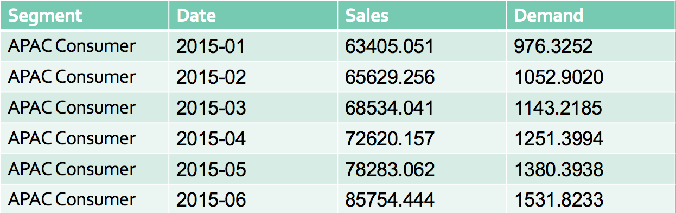
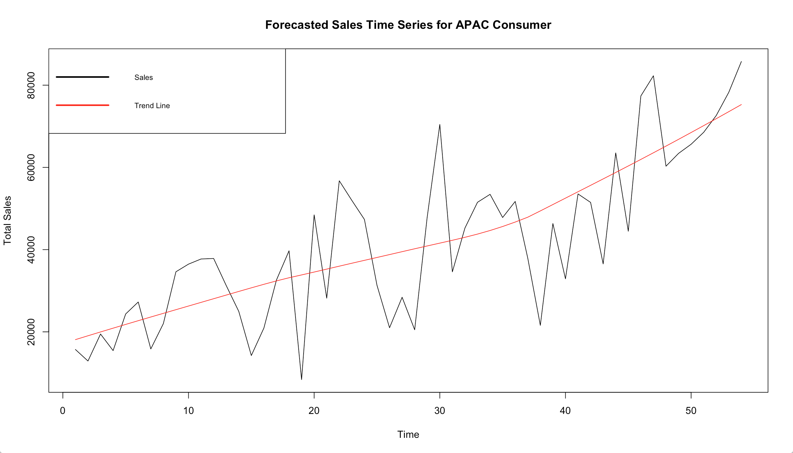
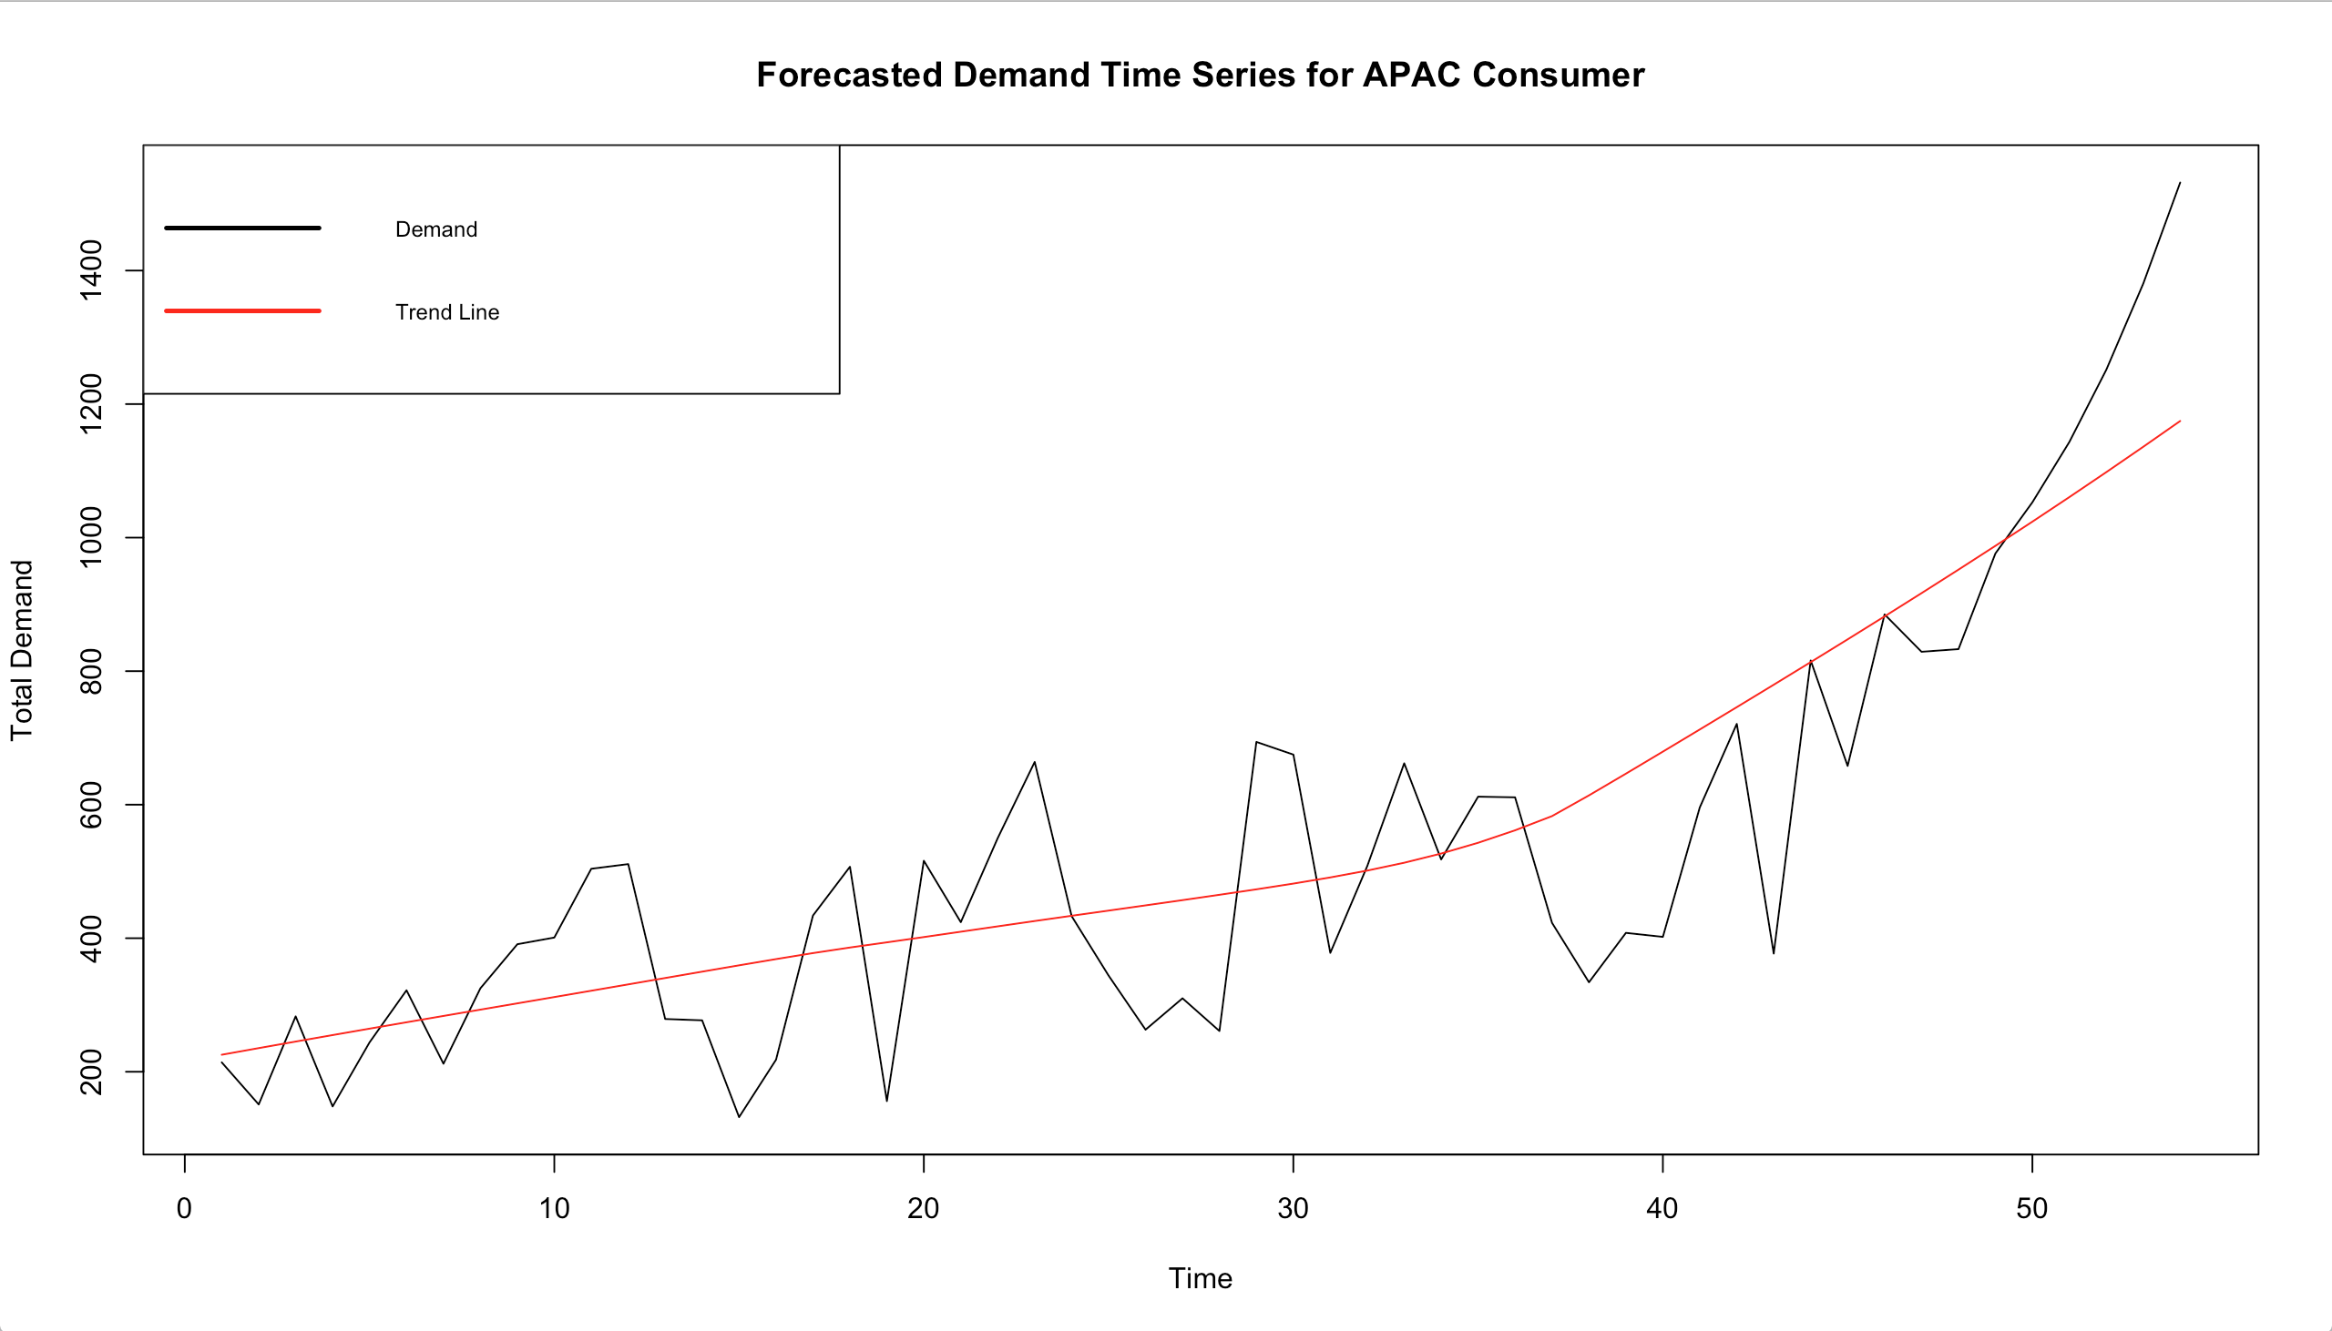
APAC Future Sales and Demand
Forecasted Sales and Demand values for the next 6 months in future

Slide 23
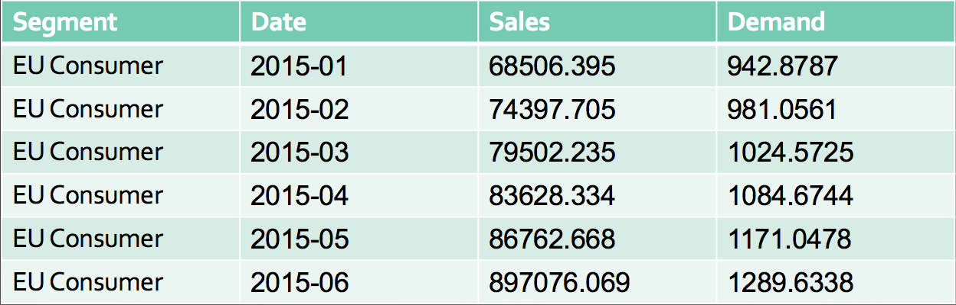
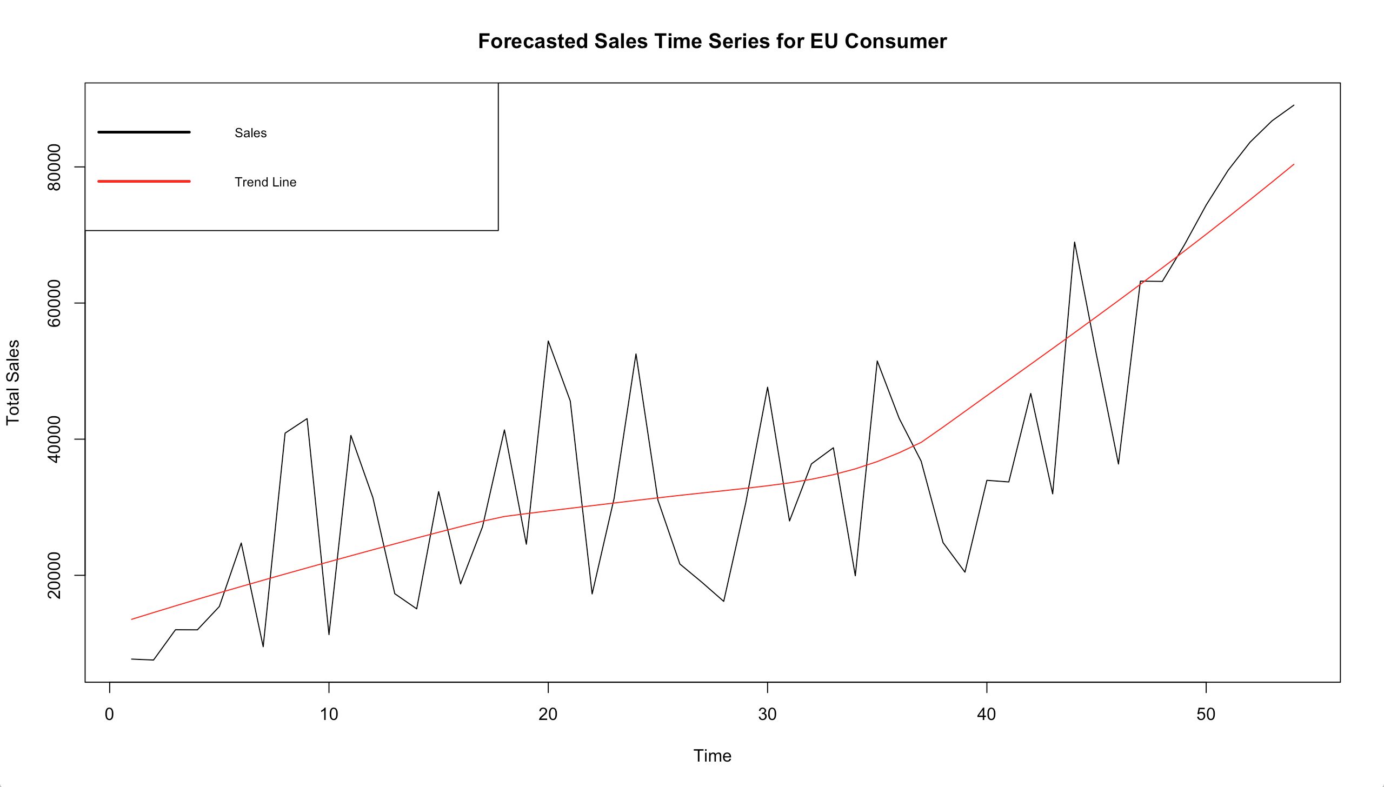
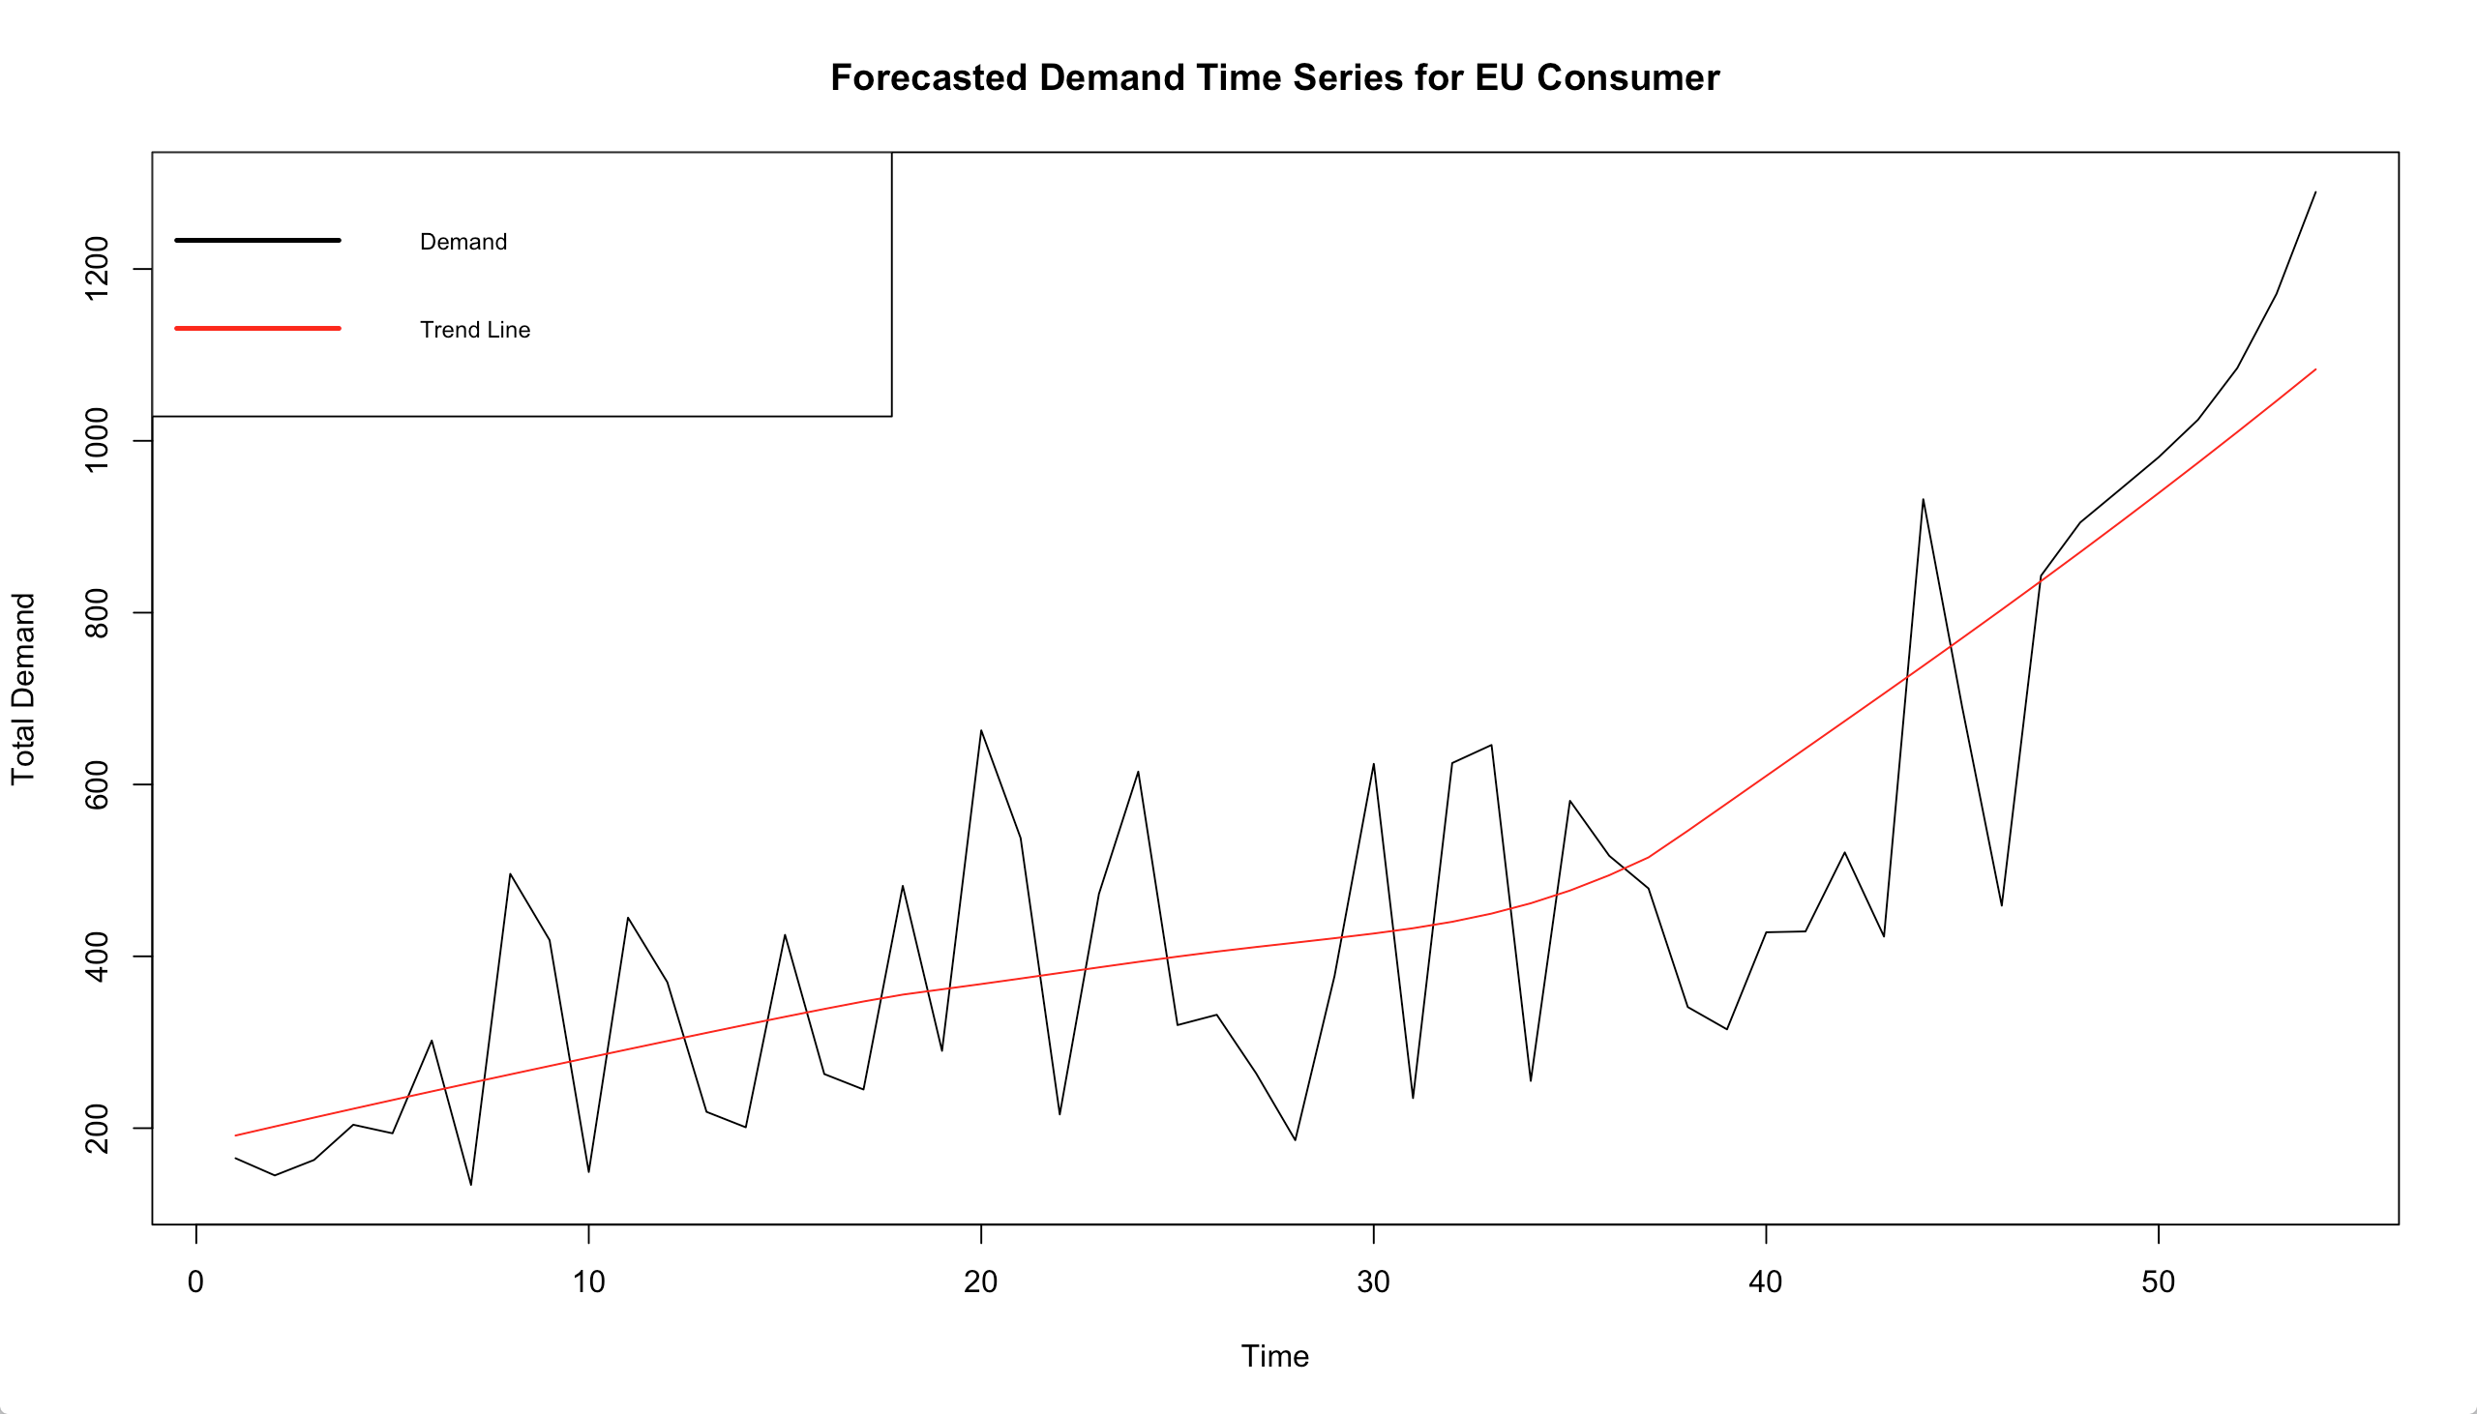
EU Future Sales and Demand
Forecasted Sales and Demand values for the next 6 months in future

